Slide 1
Android App: Exploiting Vulnerabilities and Writing Secure Code
Reviewing of vulnerabilities
Exploiting vulnerabilities
Principle of least exposure
Security mechanisms
Slowing-down a reverse engineer
Notes:
https://samsclass.info/128/128_S21.shtml#lecture

Slide 2
Reviewing of vulnerabilities
Its important to understand how an attacker uses an Android App vulnerabilities to gain access to devices.
Finding vulnerabilities in pre-installed apps → knowing more on how to compromise for a better chance of securing the apps.
Each installed App has its own attack surface that can be exploited.
Emphasis is placed on gaining root access to a device- exploiting Apps with powerful contexts is a priority for a bug hunter.
A good example of a powerful permission is the install capability.
This enables to maximize return on the invested time.

Slide 3
Reviewing …
Common Vulnerabilities:
Code injection
Logic flaws
Insecure storage
Application configuration
Insecure communication
Logging

Slide 4
Exploiting vulnerabilities
It should be clear that many vulnerabilities (remote and local) can be discovered and exploited on Android devices.
A remote exploit allows an attacker to gain a foothold on the target device.
Access can occur through a multitude of attack vectors such as software exploits, man-in-the-middle attacks, or malware.
A local exploit attempt to escalate the privileges of the malicious code or perform an action on an App that was not intended.
Notes:
A 'remote exploit' works over a network and exploits the security vulnerability without any prior access to the vulnerable system
A 'local exploit' requires prior access to the vulnerable system and usually increases the privileges of the person running the exploit past those granted by the system administrator.

Slide 5

Exploiting vulnerabilities …
Example of tools:
  Ettercap is de facto standard for performing man-in-the-middle attacks on a network-ARP poisoning, DNS spoofing, etc.
  Drozer is a framework to exploit Apps- enables sharing of exploits through a central online repository.
  Impact of the privilege levels- Install Package, ADB Shell Access, System User Access, Root User Access, etc.

Slide 6
Exploiting vulnerabilities …
Infiltrating audio:
  Infiltrate using drozer modules and record from the microphone of the device you have compromised.
  The requirements are that you have compromised an App with the RECORD_AUDIO permission and have retained Context.
Infiltrating SMS
  Infiltrate two-factor authentication that uses OTP (one-time password) tokens. dz> run post.sms.read -f OTP
  Send SMS: dz> run post.sms.send 0745678*** "My message text"

Slide 7
Exploiting vulnerabilities …
Infiltrating Contacts
  Infiltrate contacts, for example of searching by surname:
    dz> run post.contacts.read -f Derek →| Derek | 0745678*** |
Infiltrating GPS location
  Determine a user's rough location even without Wi-Fi hotspot proximity markers can- use post.capture.location.
Other infiltrations
  Capturing a user’s screen, stealing files from SD card, cracking patterns, PINs, and passwords

Slide 8
Principle of least exposure
Minimizing Attack Surface
The fewer entry points there are into an App, the smaller the attack surface is.
  Find every single portion of the App code that is exposed in some way to input from outside sources and remove it.
  If an entry point has to be exposed, perform security checks at the entry points before running other code.

Slide 9

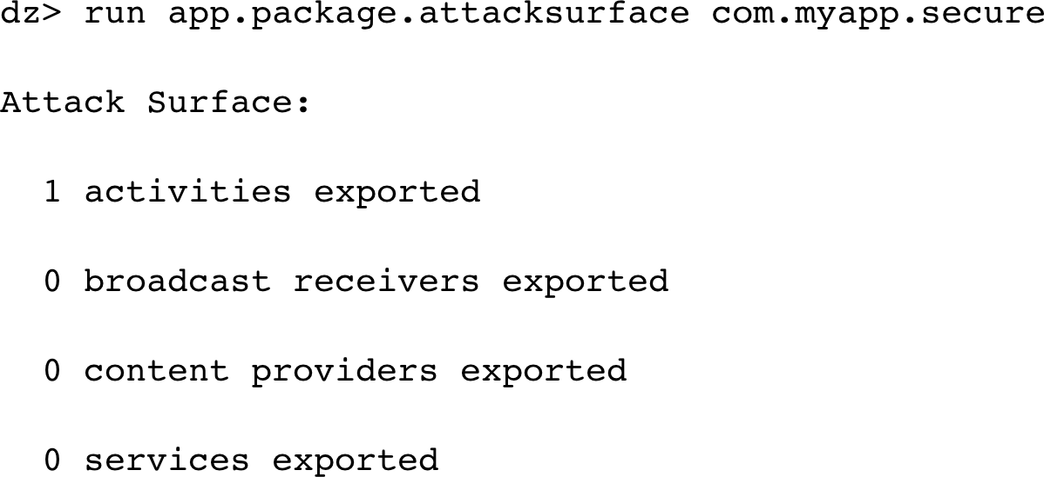
Principle …
Application components
  Apps should reduce exported components down to essential.
  Safest case is to export the main activity only.

Slide 10
Principle …
  Data storage
  Avoid storing unnecessary data- such as passwords!
  Private directory is protected by the sandboxing
  SD card is less protected
  Untrusted sources
  Inputs from SD card, Wi-Fi, Bluetooth, etc.
  Verify authenticity with signature, encryption, etc.
  Be careful loading classes or running executables from untrusted locations
  Cryptographic protections are the best
  Minimal permissions
  Request the fewest permissions needed for your app
  It is safer, and avoids worrying users
  Avoid risky permissions like:
  -sharing powerful users (android.uid.system) -INSTALL_PACKAGES
  Bundling files in the APK
  APK can contain extra files by accident
  May contain SSH credentials or other secrets

Slide 11
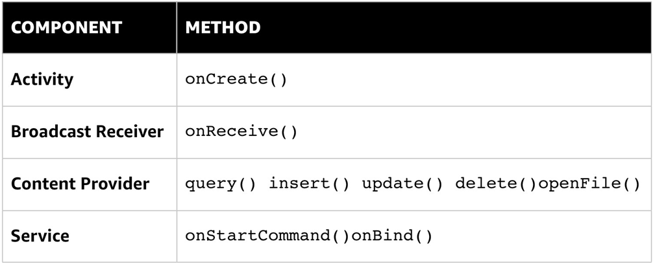
Security mechanisms
Review entry points
Trace functions that receive code from other apps inside each exported component over the IPC sandbox
Enforce permissions by setting the android: permission attribute in manifest
Permission protection
Limit permission in exported components .. only to apps with same signature
Great care is required if you really want to offer a component for public use
<uses-permission
android:name="android.permission.CAMERA"/>
Dangerous permissions:
READ_CALENDAR, WRITE_CALENDAR, CAMERA, READ_CALL_LOG, WRITE_CALL_LOG, READ_CONTACTS, WRITE_CONTACTS, GET_ACCOUNTS, ACCESS_FINE_LOCATION, ACCESS_COARSE_LOCATION, SEND_SMS, RECEIVE_SMS

Slide 12
Security mechanisms …
Securing Activities:
Task manager snooping
Remove your app from the recent app list- to avoid exposing private information on that image
Put this code in OnCreate() to show a blank screen in the list
getWindow().addFlags(WindowManager.LayoutParams.FLAG_SECURE;
Set this attribute in an activity to remove it entirely from the list
intent.addFlags(Intent.FLAG_ACTIVITY_EXCLUDE_FROM_RECENTS);
Tapjacking
Prevent touches from being sent through elements with this attribute:
android:filterTouchesWhenObscured="true"
Or by using this method:
view.setFilterTouchesWhenObscured(true);
Secure trust boundaries
Make sure there's no way to open an authenticated activity from unauthenticated areas of the app
One way: implement an app-wide authentication variable
Browsable Activities
Can be used directly from a web browser
High-value targets for attackers- avoid using BROWSABLE
If you use it, consider all possible intents that could cause actions in your app
Other mechanisms
Disable additions to the dictionary to keep secrets out and mask password displays.
Add this attribute to an EditText box:
android:inputType="textVisiblePassword"
android:inputType="textPassword"
Securing Android activities

Slide 13
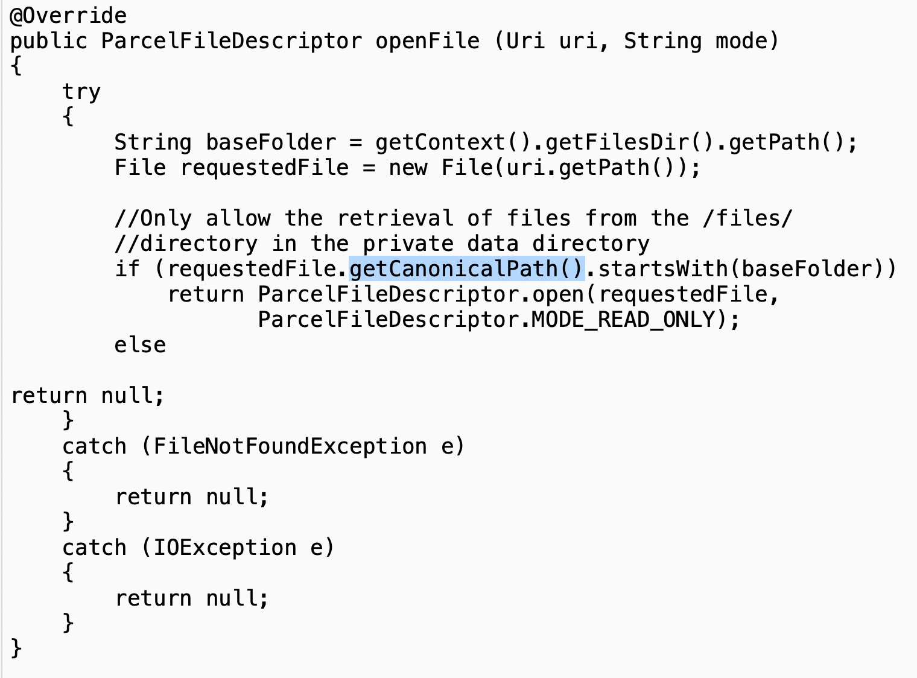
Security mechanisms …
Securing Content Providers:
Default export behavior
Prior to API 17, content providers were exported by default
To prevent this, put this code in the manifest:
<provider android:name=".ContentProvider“
android:authorities="com.myapp.ContentProvider" android:exported="false" >
</provider>
SQL injection
Avoid direct user input inside SQL statement in rawQuery() SQLite method by concatenating queries- use prepared statements instead:
String[] userInput = new String[] {"book", "wiley"};
Cursor c = database.rawQuery("SELECT * FROM Products WHERE type=? AND brand=?", userInput);
Directory traversal
The getCanonicalPath() method removes the “..” characters and provides the absolute path to a file
This code uses traverses to limit paths to the /files/ subdirectory of the app's private data directory

Slide 14
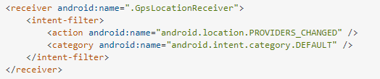
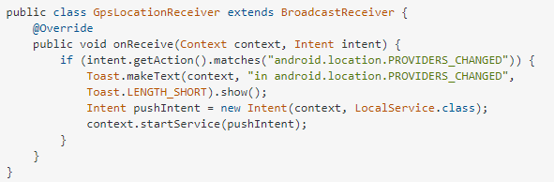
Security mechanisms …
Securing Broadcast Receivers:
Secret codes are easily enumerated using apps on the Play Store
An attacker who knows your implemented secret code should not be able to have any control over the App.
Secret codes should be used only for testing purposes and must be removed before releasing the application.
Ensure that the code in the broadcast receiver cannot perform an unintended action by invoking the secret code.

Slide 15
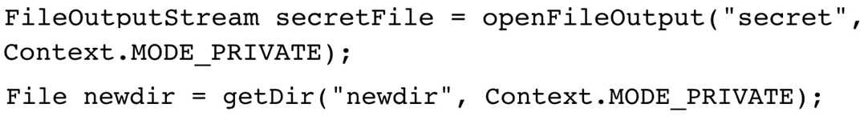
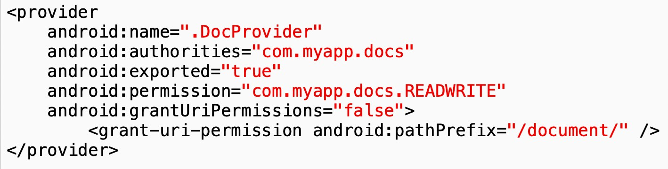
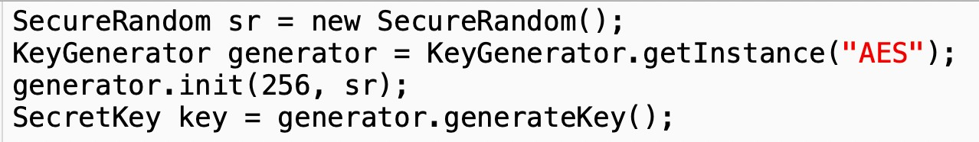
Security mechanisms …
Storing Files Securely:
Encryption
Use AES for symmetric encryption, avoid ECB
Use RSA-2048 for asymmetric encryption
Password hashing advice- salting
Creating Files and Folders
Explicitly set permissions
Random numbers
Random() produces the same series of numbers each time it's run from the same seed
Better use SecureRandom- Java provides methods to seed it from a source of entropy
Key generation- PBKDF2 uses many rounds of hashing to derive a key from a password & be stored in Keystore
Exposing files
To allow specified other apps to see a file
Those apps need com.myapp.docs.READWITE permission.
Notes:
Link to random number code in Java: https://replit.com/~
Electronic Code Book (ECB) is a simple mode of operation with a block cipher that's mostly used with symmetric key encryption.
The Advanced Encryption Standard (AES) is a symmetric block cipher chosen by the U.S. government to protect classified information.
Entropy, in cyber security, is a measure of the randomness or diversity of a data-generating function. Data with full entropy is completely random and no meaningful patterns can be found.
PBKDF1 and PBKDF2 (Password-Based Key Derivation Function 1 and 2) are key derivation functions with a sliding computational cost, used to reduce vulnerabilities of brute-force attacks. PBKDF2 is part of RSA Laboratories' Public-Key Cryptography Standards (PKCS) series, specifically PKCS #5 v2.

Slide 16
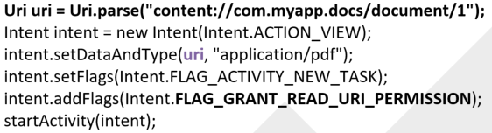
Security mechanisms …
Secure Communication & WebView:
HTTPS
HTTPS is much safer than HTTP, but depends on trusted Certificate Authorities (CAs)
Certificate pinning makes HTTPS even more secure- requiring a specific certificate or CA
WebView
WebView enables to display a Web page in an activity
Often leads to security problems- if loaded over HTTP, subject to interception and modification
More info- https://www.checkmarx.com/blog/android- webview-secure-coding-practices/
Local Communications
Transferring data from one app to another
Android API is the best method
- Activities with intent-filters
- In more recent Android versions- ChooserTargets, Shortcuts, etc.
Using network sockets or the clipboard is less safe
  Expose files securely when sending to other Apps.
Notes:
Pinning is the process of associating a host with their expected X509 certificate or public key. Once a certificate or public key is known or seen for a host, the certificate or public key is associated or 'pinned' to the host.

Slide 17
Security mechanisms …
Configuring the Android Manifest:
Backups and Debugging
If android:allowBackup is false, an attacker can't back up files with physical access to the device
android:debuggable allows debugging
API Version Targeting
minSdkVersion should be as large as possible
Lower values remove new security fixes
Values below 17 export content providers by default

Slide 18
Slowing down a reverse engineer
Android Apps can easily be decompiled into readable source code.
Example, try using decompiler to decompile Sieve.apk
Tamper detection can be used by which an App is designed to fail to run if it detects signs of modification of its APK file.
For example, a reverse engineer may have modified a manifest to include android:debuggable=”true”.

Slide 19
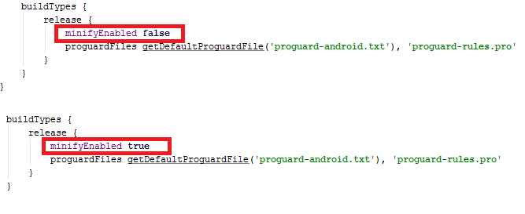
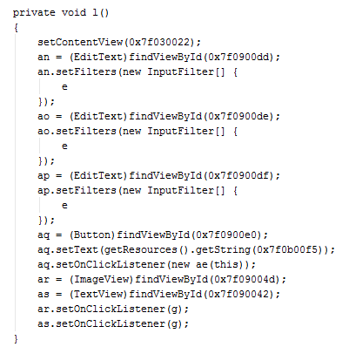
Slowing down …
So, security efforts may only slow down a reverse engineer by making the analysis task more difficult.
Use obfuscators to make decompiled code less readable and harder to follow.
Example of obfuscators- ProGuard, DashO, DexGuard, etc.
In Android studio, install ProGuard plugin, change the minifyEnabled property to true- names of classes, methods and variables get like a, b, c, ab, etc.

Slide 20
Class activities:
Individual participation 1: Discussion questions via Mentimeter (Week 43)
Individual participation 2: Questions via Kahoot (Week42/43)
Group activity: List of activities to be provided
Work on “Obligatory assignment 2“
NB: Additional information about the activities yet to be provided in separate document.

Slide 21
Next topics
Security in iOS Applications

